Slide 1
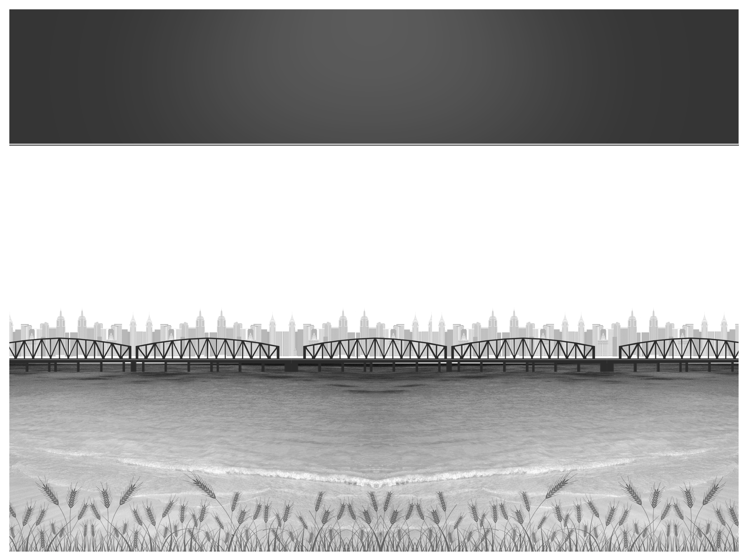


Sumeru On Rails
Make your own Rails frame work
By: Pankaj Bhageria
Tech Lead
Sumeru Software Solutions
Website: sumeruonrails.com
Blog: railsguru.org

Slide 2

3 Questions ?
Have you ever thought of creating
your own Web Framework?
Have you ever peeped through the source
code of Rails Framework?
Have you contributed to the Rails
communtiy?

Slide 3
Why Am I here?
It is my vision to have India contribute
significantly to the Rails world.

Slide 4

What stops you from this?
Fear factor
Understanding
Critics
Results

Slide 5
Objectives
To inspire you, so that, you start
Contributing to Rails
Start writing your own gems
Doing your own experiments
Start thinking big
Talk at the next Rubyconf

Slide 6
Minimum Qualification
Basic knowledge of Ruby and Rails.

Slide 7
Over Qualification
If you are a guru in Ruby and Rails
If you are already contributing to Rails and open source.
If you have built some frameworks.

Slide 8

A journey of a thousand miles begins with a single step. Lao-tzu Chinese philosopher (604 BC - 531 BC)

Slide 9
The Single Step
We will build a basic web server and demonstrate
Routing
Controllers and Action
Views

Slide 10

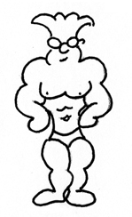

Understanding RACK
Hey I got a Request
/login
/login
Message converted to
app.call(“/login”)
Response
[200,header,”Login Form”]
app.call(“/login”)
MONGREL
Request
/login
WEBRICK
Need a Savior
Multiple WEB SERVERS
DUPLICATION
PASSENGER
Response
“Login Form”
[200,header,”Login Form”]
THIN
WEB SERVER
RACK
WEB APPLICATION
”Login Form”

Slide 11
What is a Framework?
A framework is a library which makes writing web applications faster
Web Framework
Developer Code
RACK
WEB APPLICATION

Slide 12
Integrating with Rack
To communicate with Rack, the web application should be a ruby object which respond to a call method
The Call method should
Accept a key value pair
Return an array [status, header, body]

Slide 13
Integrating with Rack
# myserver.rb
class MyServer
def call(env)
[200,{"content-type"=>"text/html"},“Login Here"]
end
end

Slide 14
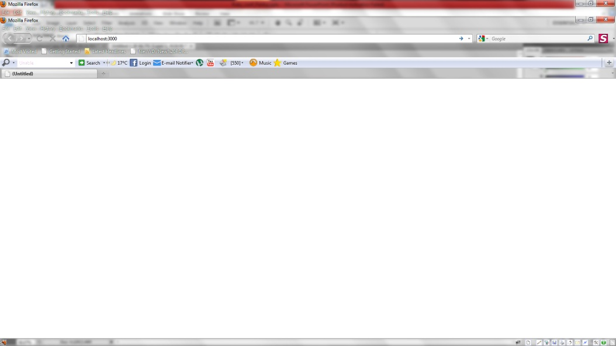
Integrating with Rack
#config.ru
require "rack“
require “myserver“
run MyServer.new
To run the server we do
rackup config.ru –p 3000
Login Here
Execute

Slide 15

Integrating with Rack
We have now a functional Web Application which can communicate to Rack.

Slide 16
Lets see what Rack Sends To Webserver
# myserver.rb
class MyServer
def call(env)
[200,{"content-type"=>"text/html"},env.inspect]
end
End

Slide 17
A look at the request
http://localhost:3001/login?username=pankaj
{"HTTP_HOST"=>"localhost:3001", "HTTP_ACCEPT"=>"text/html,application/xhtml+xml,application/xml;q=0.9,*/*;q=0.8", "SERVER_NAME"=>"localhost", "REQUEST_PATH"=>"/login", "rack.url_scheme"=>"http", "HTTP_KEEP_ALIVE"=>"300", "HTTP_USER_AGENT"=>"Mozilla/5.0 (Windows; U; Windows NT 6.1; en-GB; rv:1.9.1.7) Gecko/20091221 Firefox/3.5.7", "REMOTE_HOST"=>"SAMLP05110000", "rack.errors"=>#>, "HTTP_ACCEPT_LANGUAGE"=>"en-gb,en;q=0.5", "SERVER_PROTOCOL"=>"HTTP/1.1", "rack.version"=>[1, 1], "rack.run_once"=>false, "SERVER_SOFTWARE"=>"WEBrick/1.3.1 (Ruby/1.8.7/2011-02-18)", "REMOTE_ADDR"=>"127.0.0.1", "PATH_INFO"=>"/login", "SCRIPT_NAME"=>"", "HTTP_VERSION"=>"HTTP/1.1", "rack.multithread"=>true, "rack.multiprocess"=>false, "REQUEST_URI"=>"http://localhost:3001/login?username=pankaj", "HTTP_ACCEPT_CHARSET"=>"ISO-8859-1,utf-8;q=0.7,*;q=0.7", "SERVER_PORT"=>"3001", "REQUEST_METHOD"=>"GET", "rack.input"=>#>, "HTTP_ACCEPT_ENCODING"=>"gzip,deflate", "HTTP_CONNECTION"=>"keep-alive", "QUERY_STRING"=>"username=pankaj", "GATEWAY_INTERFACE"=>"CGI/1.1"}

Slide 18
Lets Add some routing
Mapping the request path(url) to the corresponding action and controller is routing
/login => controller:Sessions, action: new
/logout => controller:Sessions, action: destroy

Slide 19
Define Routes
DEVCODE
#routes
match "/login"=>"sessions#new“
match "/home"=>“home#index"

Slide 20
Define Routes
class MyServer
@@routes_collection = []
..
def self.match(route)
@@routes_collection << MyRoute.new(route)
end
end

Slide 21
Framework: route
class MyRoute
attr_accessor :path, :controller, :action
def initialize(options)
path = options.keys[0]
x = options.values[0].split(“#”)
controller = x[0]
action = x[1]
end
def match(match_path)
path == match_path
end
end

Slide 22
Framework: map_routes
class MyServer
def map_routes(path)
@@routes_collection.each do |route|
if route.match (path)
return route.controller, route.action
break
end
….
end
end

Slide 23
Lets Define Controllers and Action
class HomeController
def index
“Home Page"
end
end
class SessionsController
def new
"login here"
end
end

Slide 24
Revision
# myserver.rb
class MyServer
def call(env)
[200,{"content-type"=>"text/html"},“Login Here"]
end
end

Slide 25
Putting it together
class MyServer
def call(env)
path = env["PATH_INFO"]
controller,action = map_routes(path)
if controller
controller_name = controller_name (controller)
body = eval( "#{controller_name}.new.#{action}" )
else
body = ["Page not found"]
end
status = 200
header = {"content-type"=>"text/html"}
[status,header,body]
end
end
# /login
# “sessions”, “new”
# SessionsController
# “Login Here “
Login Here
Execute

Slide 26
Lets Render Some views:
require 'erubis'
class MyActionController
def render(options)
@status = 200
if options[:text]
@body = options[:text]
elsif options[:file]
@body = render_erb_file(views + options[:file] + .erb)
end
end
def render_erb_file(file)
input = File.read(file)
eruby = Erubis::Eruby.new(input)
@body = eruby.result(binding())
end
end

Slide 27
Use render :text
class SessionsController < MyActionController
def new
render :text=>”Login Here, from render text”
end
end
Login Here from render text
Execute

Slide 28
Use render :file
class SessionsController < MyActionController
def new
render :file=>”sessions/new”
end
end
#view file: sessions/new.erb
<p>Login Page. This content is coming from file sessions/new.rb </p>
Login Page. This content is coming
from file sessions/new.rb
Execute

Slide 29
End of our first step
We have built a basic web server and covered the following features
Routing
Controllers and Action
Views

Slide 30

Where do you go from here

Slide 31
Where do you go from here
Start, do not wait
Start looking at rails code
Start developing your gems
Start writing your blogs
Form groups and meetup monthly and share your knowledge.
Look at others code.
Contact me at pankaj.bhageria@sumerusolutions.com

Slide 32

Take Away
You must believe

Slide 33

Any Queries?
?
Thank you
Need Ruby/Rails training? Contact us at rails@sumerusolutions.com
We are also Training Partners for Zero to Rails 3 course

